Slide 1
POWER UP YOUR
PROJECT WITH DART BACKEND

Slide 2
All functions or variables used in this project are imaginary. The errors that come while compiling can be baseless. Do not pay much attention to them or let them affect your life.
इस प्रोजेक्ट में प्रयोग किये गये सभी फंक्शन या वेरिएबल कालपनिक है। कंपाइल करते समय आने वाले एरर बे-बुनियाद हो सकते हैं। उनपे ज्यादा ध्यान ना दे या ना ही उनका असर अपने जीवन में होने दे।
जनहित में जारी

Slide 3
A little bit about me
🔤 My name is Cavin Macwan
👨‍💻 Flutter Developer at 7Span
✍️ Blogger and Speaker 🗣️
💙 Finished #100DaysWithFlutter
🏀 Has been National Basketball Player
🤩 Google “Cavin Macwan” to see my people card 😊

Slide 4
THINGS THAT WE ARE GONNA COVER TODAY?
Step 1
Current Scenario of a Flutter Developer 👨‍💻
Step 2
What is Dart Backend and do we need it? 🤔
Step 3
What are the available options ✨
Step 4
Won’t let you go without a Demo 😉

Slide 5
Typical day-to-day Job as a Flutter Developer
Come to the office 🏢
See the unresolved JIRA tickets and cry 🥲
Start integrating the APIs 🔗

Slide 6
If often feels like this

Slide 7
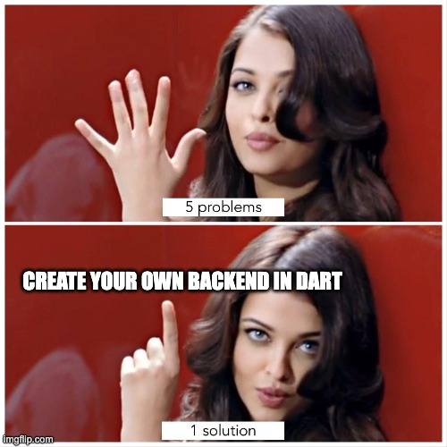
What is the solution then? 🤔

Slide 8
But why anyone would want Dart as a backend? 🤔

Slide 9
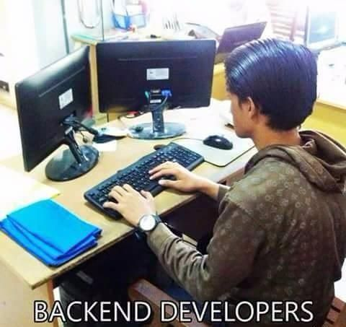
2. What is a Backend?
Backend means an application that runs on a server and can handle client requests.
It deals with Databases and APIs

Slide 10



2.1 Why do we need Dart🎯 in it?
Reason - 1
Context switching

Slide 11
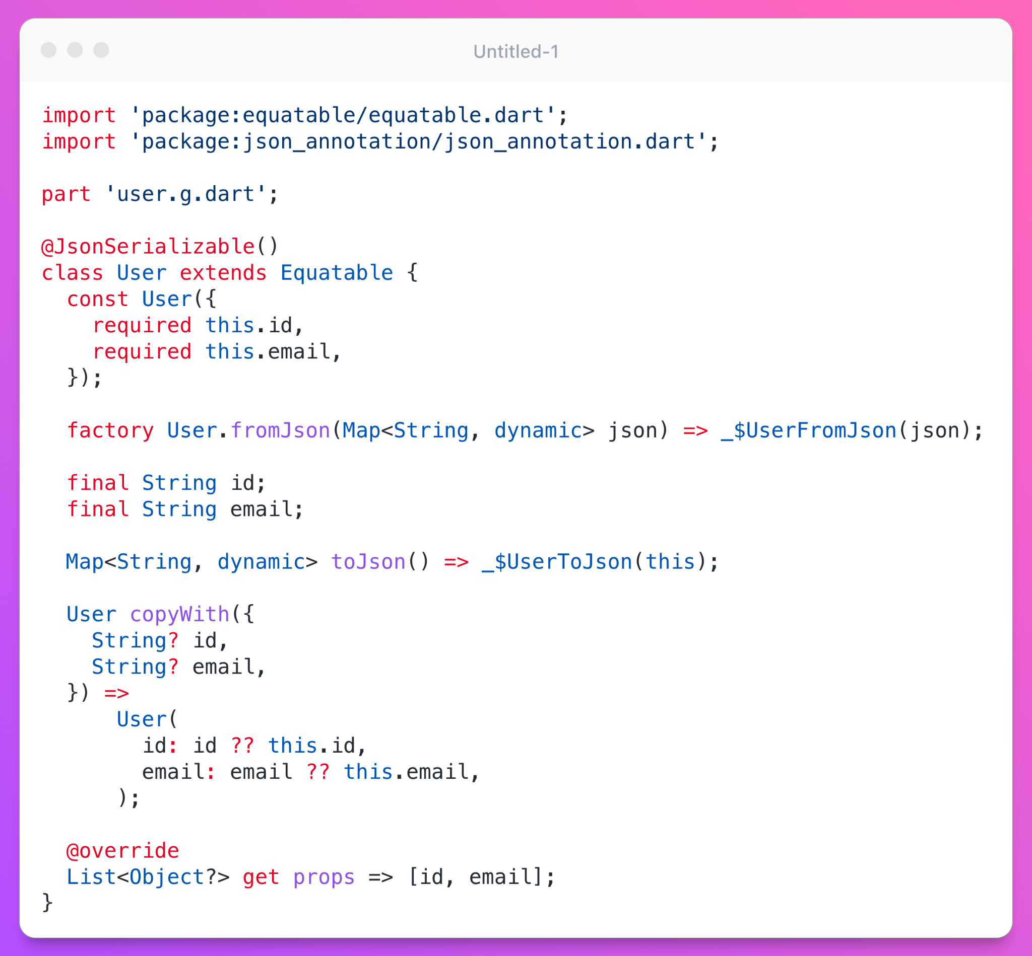
Reason 2: Code Sharing

Slide 12
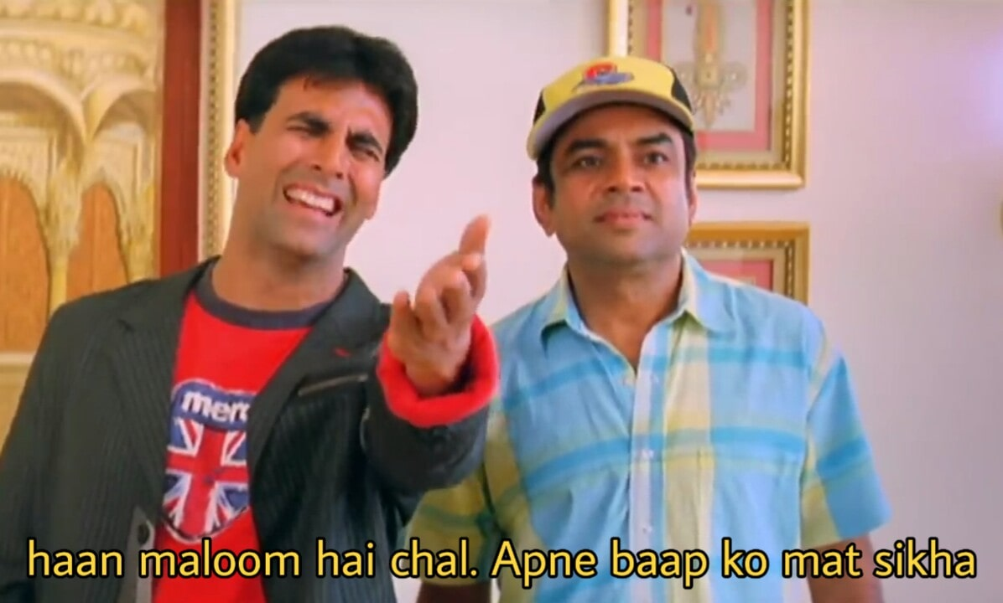
Reason 3: Dart Features
Null - Safety (Sound Null Safety 💂)
All new Dart 3 features like records, patterns, class modifiers
Bundle Size

Slide 13
3. What are the available options?
 | Shelf | Dart Frog | Serverpod
Documentation 📄 | Poor | High | High
Features ✨ | Medium | Medium | High
Community 👨‍👨‍👦‍👦 | Small | Large | Medium
Ease of learning 📕 | Hard | Easy | Medium

Slide 14
Is Dart a new language?
1990
C
1991
Python
1995
Java
2000
C#
2005
Ruby
2009
Swift
2013
Dart
2014
Kotlin

Slide 15
Why Did I Choose Dart Frog?
Feature 1
Feature 2
Feature 3
Feature 4
It is built on top of Shelf and Mason
It is made by the creator of BLoC
The community is very good
It was easier for me to explain 😉

Slide 16
LET’S GET STARTED WITH DART FROG
Create your project
dart_frog create my_project
Run the magical command
Start Server
dart pub global activate dart_frog_cli
dart_frog dev

Slide 17

DEMO

Slide 18
Some Learning Resources
Dart Frog’s official documentation: https://dartfrog.vgv.dev/docs/overview
Awesome Dart Frog’s Repository that contains all the Video tutorials as well as Articles: https://github.com/VeryGoodOpenSource/awesome_dart_frog
Make it work, make it right, make it fast - Not By Me

Slide 19
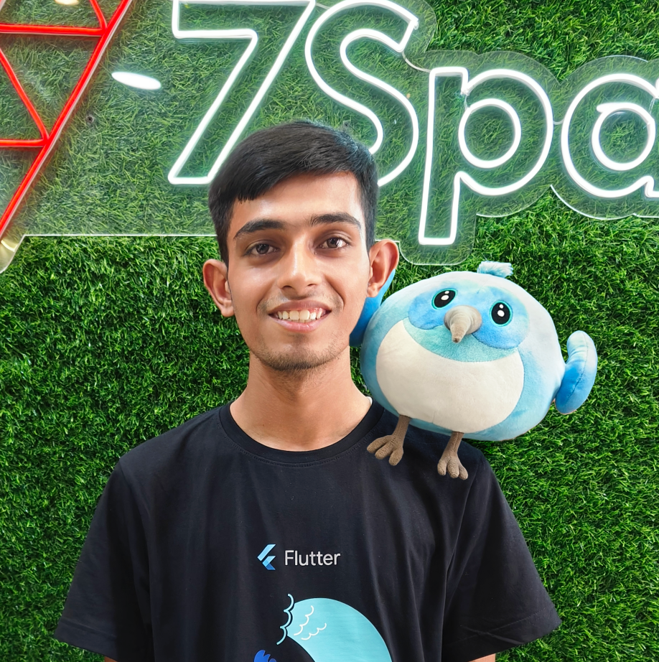


Follow me on
LinkedIn and Twitter
cavin-macwan
cavin_1910

